Slide 1
Markov Process
Stochastic Process
Markov Property

Slide 2
What is “Discrete Time”?
time
0
1
2
3
4
Events occur at a specific points in time

Slide 3









What is “Stochastic Process”?
State Space = {SUNNY,
RAINNY}
Day
Day 1
Day 2
Day 3
Day 4
Day 5
Day 6
Day 7
THU
FRI
SAT
SUN
MON
TUE
WED
X(day_{i}): Status of the weather observed each DAY

Slide 4
Markov Processes
Stochastic Process X(t) is a random variable that varies with time.
A state of the process is a possible value of X(t)
Markov Process
  The future of a process does not depend on its past, only on its present
  a Markov process is a stochastic (random) process in which the probability distribution of the current value is conditionally independent of the series of past value, a characteristic called the Markov property.
  Markov property: the conditional probability distribution of future states of the process, given the present state and all past states, depends only upon the present state and not on any past states
Marko Chain: is a discrete-time stochastic process with the Markov property

Slide 5
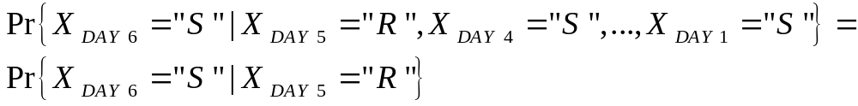
What is “Markov Property”?
PAST EVENTS
NOW
FUTURE EVENTS
?
Probability of “R” in DAY6 given all previous states
Probability of “S” in DAY6 given all previous states
Day
Day 1
Day 2
Day 3
Day 4
Day 5
Day 6
Day 7
THU
FRI
SAT
SUN
MON
TUE
WED
Markov Property: The probability that it will be (FUTURE) SUNNY in DAY 6
given that it is RAINNY in DAY 5 (NOW) is independent from PAST EVENTS

Slide 6
Notation
Discrete time t_{k} or k
Value of the stochastic
process at instant t_{k} or k
X(t_{k}) or X_{k} = x_{k}
The stochastic process at time t_{k} or k

Slide 7
Markov Chain
Discrete Time Markov Chains (DTMC)

Slide 8
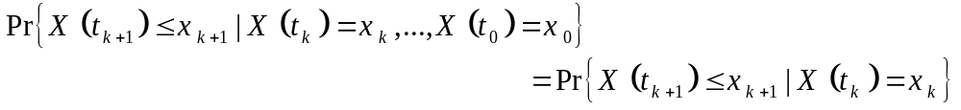
Markov Processes
Markov Process
  The future of a process does not depend on its past, only on its present
Since we are dealing with “chains”, X(ti) = Xi can take discrete values from a finite or a countable infinite set.
The possible values of Xi form a countable set S called the state space of the chain
For a Discrete-Time Markov Chain (DTMC), the notation is also simplified to
Where X_{k} is the value of the state at the kth step

Slide 9
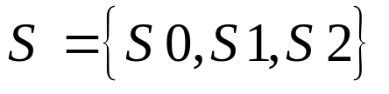
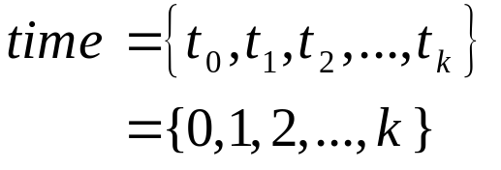
General Model of a Markov Chain
p₁₁
p₀₁
p₁₂
p₂₂
p₀₀
S0
S1
S2
p₁₀
p₂₁
p₂₀
Discrete Time (Slotted Time)
State Space
i
Si
State i
or
p_{ij}
Transition Probability from State Si to State Sj

Slide 10

Example of a Markov Process
A very simple weather model
p_{SR}=0.3
p_{SS}=0.7
SUNNY
RAINY
p_{RR}=0.4
p_{RS}=0.6
State Space
If today is Sunny, What is the probability that to have a SUNNY weather after 1 week?
If today is rainy, what is the probability to stay rainy for 3 days?
Problem: Determine the transition probabilities from one state to another after n events.

Slide 11
Chapman Kolmogorov Equation
Determine transition probabilities from one state to anothe after n events.

Slide 12

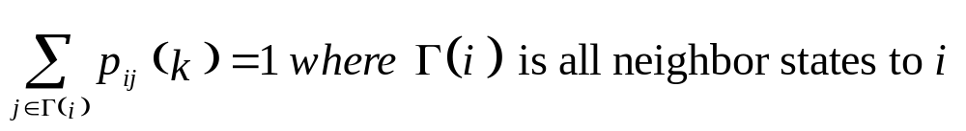
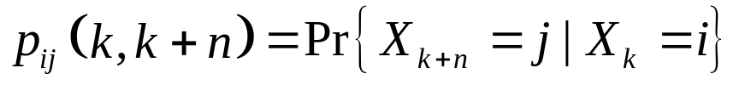
Chapman-Kolmogorov Equations
We define the one-step transition probabilities at the instant k as
Necessary Condition: for all states i, instants k, and all feasible transitions from state i we have:
We define the n-step transition probabilities from instant k to k+n as
x₁
x_{i}
…
x_{j}
x_{R}
Discrete time
k
k+1
u
k+n

Slide 13


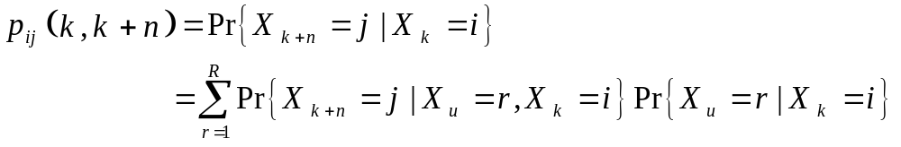
Chapman-Kolmogorov Equations
Using Law of Total Probability
x₁
x_{i}
…
x_{j}
x_{R}
Discrete time
k
k+1
u
k+n

Slide 14
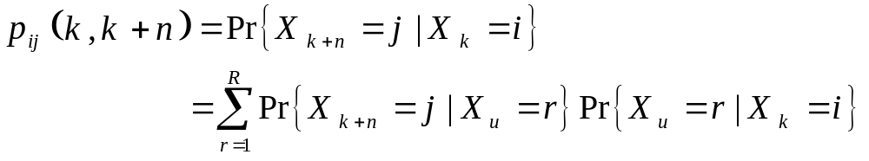
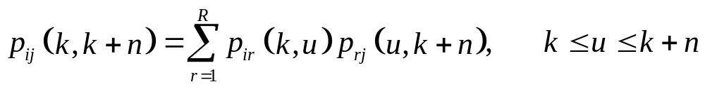
Chapman-Kolmogorov Equations
Using the memoryless property of Markov chains
Therefore, we obtain the Chapman-Kolmogorov Equation

Slide 15
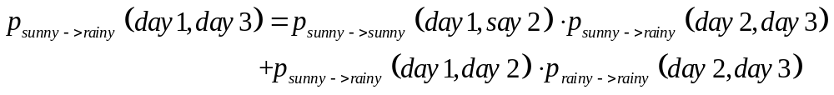
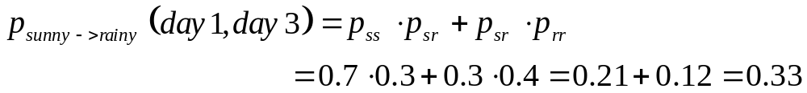
Chapman-Kolmogorov Equations
Example on the simple weather model
p_{SR}=0.3
p_{SS}=0.7
SUNNY
RAINY
p_{RR}=0.4
p_{RS}=0.6
What is the probability that the weather is rainy on day 3 knowing that it is sunny on day 1?

Slide 16
Transition Matrix
Generalization Chapman-Kolmogorov Equations

Slide 17
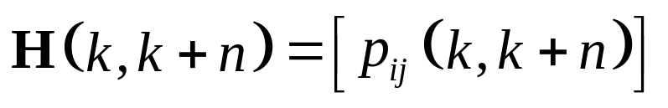
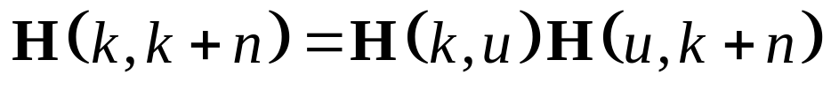
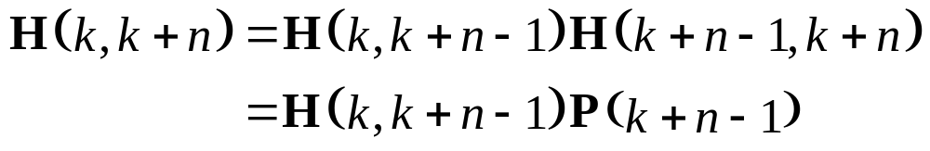
Transition Matrix
Simplify the transition probability representation
Define the n-step transition matrix as
We can re-write the Chapman-Kolmogorov Equation as follows:
Choose, u = k+n-1, then
Forward
Chapman-Kolmogorov
One step transition probability

Slide 18
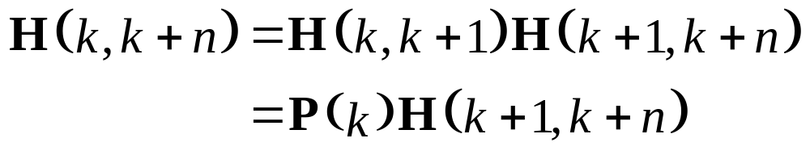
Transition Matrix
Simplify the transition probability representation
Choose, u = k+1, then
Backward
Chapman-Kolmogorov
One step transition probability

Slide 19
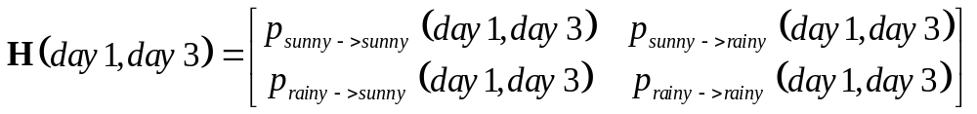
Transition Matrix
Example on the simple weather model
p_{SR}=0.3
p_{SS}=0.7
SUNNY
RAINY
p_{RR}=0.4
p_{RS}=0.6
What is the probability that the weather is rainy on day 3 knowing that it is sunny on day 1?

Slide 20

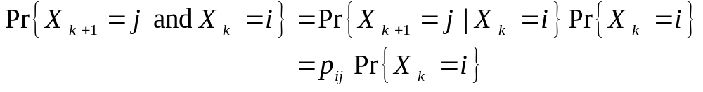
Homogeneous Markov Chains
Markov chains with time-homogeneous transition probabilities
Time-homogeneous Markov chains (or, Markov chains with time-homogeneous transition probabilities) are processes where
The one-step transition probabilities are independent of time k.
is said to be Stationary Transition Probability
Even though the one step transition is independent of k, this does not mean that the joint probability of X_{k+1} and X_{k} is also independent of k. Observe that:

Slide 21
Two Minutes Break
You are free to discuss with your classmates about the previous slides, or to refresh a bit, or to ask questions.

Slide 22
Example: Two Processors System
Consider a two processor computer system where, time is divided into time slots and that operates as follows:
  At most one job can arrive during any time slot and this can happen with probability α.
  Jobs are served by whichever processor is available, and if both are available then the job is given to processor 1.
  If both processors are busy, then the job is lost.
  When a processor is busy, it can complete the job with probability β during any one time slot.
  If a job is submitted during a slot when both processors are busy but at least one processor completes a job, then the job is accepted
  (departures occur before arrivals).
Q1. Describe the automaton that models this system (not included).
Q2. Describe the Markov Chain that describes this model.

Slide 23
Example: Automaton (not included)
Let the number of jobs that are currently processed by the system by the state, then the State Space is given by X= {0, 1, 2}.
Event set:
  a: job arrival,
  d: job departure
Feasible event set:
  If X=0, then Γ(X)= a
  If X= 1, 2, then Γ(Χ)= a, d.
State Transition Diagram
- / a,d
a
a
-/a/ad
-
0
1
2
d
d / a,d,d
dd

Slide 24
Example: Alternative Automaton
(not included)
Let (X₁,X2) indicate whether processor 1 or 2 are busy, X_{i}= {0, 1}.
Event set:
  a: job arrival, d_{i}: job departure from processor i
Feasible event set:
  If X=(0,0), then Γ(X)= a If X=(0,1) then Γ(Χ)= a, d₂.
  If X=(1,0) then Γ(Χ)= a, d₁. If X=(0,1) then Γ(Χ)= a, d₁, d₂.
State Transition Diagram
- / a,d₁
a
a
10
-/a/ad₁/ad₂
d₁
a,d₁,d₂
-
00
11
a,d₂
d₁,d₂
d₂
01
d₁
-

Slide 25




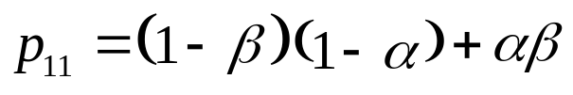
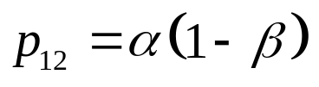

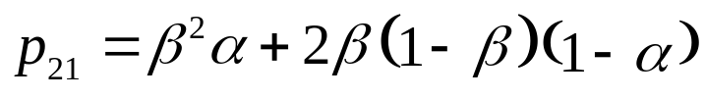
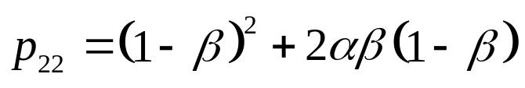
Example: Markov Chain
For the State Transition Diagram of the Markov Chain, each transition is simply marked with the transition probability
p₁₁
p₀₁
p₁₂
p₂₂
p₀₀
0
1
2
p₁₀
p₂₁
p₂₀

Slide 26
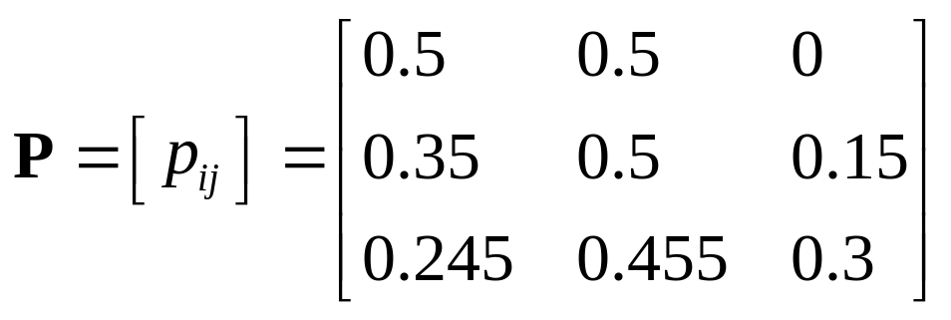
Example: Markov Chain
p₁₁
p₀₁
p₁₂
p₂₂
p₀₀
0
1
2
p₁₀
p₂₁
p₂₀
Suppose that α = 0.5 and β = 0.7, then,

Slide 27
State Holding Time
How much time does it take for going from one state to another?

Slide 28

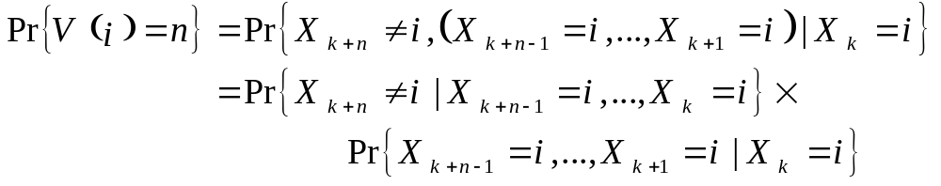
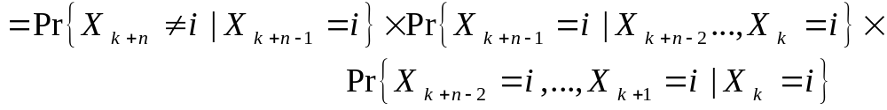
State Holding Times
Suppose that at point k, the Markov Chain has transitioned into state X_{k}=i. An interesting question is how long it will stay at state i.
Let V(i) be the random variable that represents the number of time slots that X_{k}=i.
We are interested on the quantity Pr{V(i) = n}

Slide 29
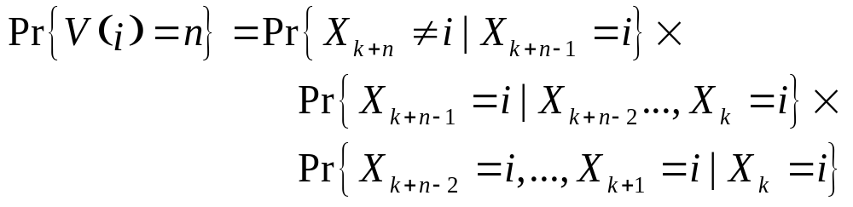
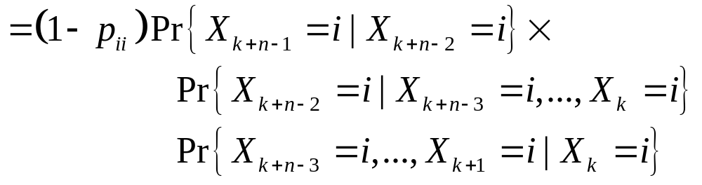
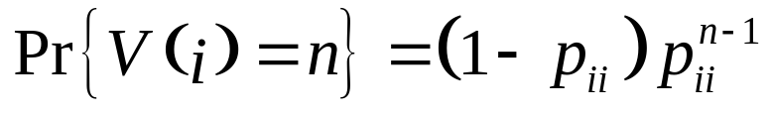
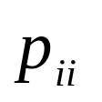
State Holding Times
This is the Geometric Distribution with parameter
Clearly, V(i) has the memoryless property

Slide 30
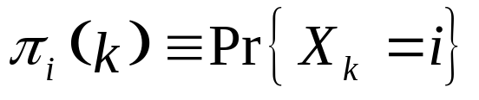
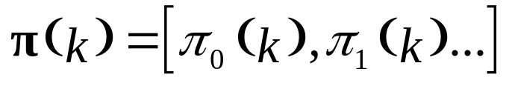
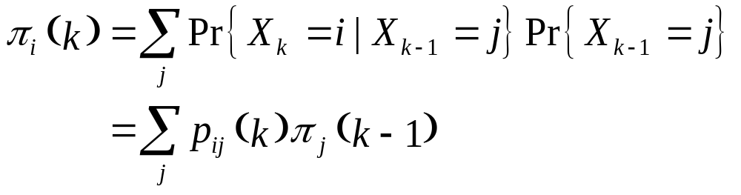
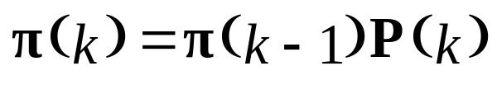
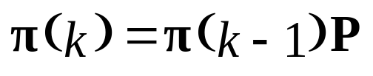
State Probabilities
An interesting quantity we are usually interested in is the probability of finding the chain at various states, i.e., we define
For all possible states, we define the vector
Using total probability we can write
In vector form, one can write
Or, if homogeneous Markov Chain

Slide 31
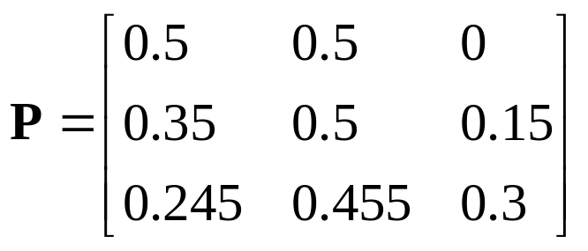
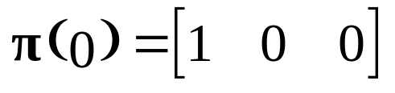
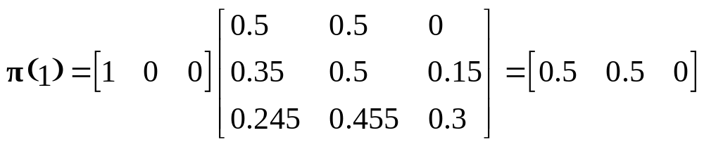
State Probabilities Example
Suppose that
with
Find π(k) for k=1,2,…
Transient behavior of the system
In general, the transient behavior is obtained by solving the difference equation

